Slide 1
Online Bus Booking System
Vikas Landge - 140099
Paurnima Salve - 140096
Shubham Kadam -140094

Slide 2
Introduction
Online Bus Ticket Booking system

Slide 3
INTRODUCTION
The Online Bus Ticket Reservation System is a web-based application that allows visitors check bus ticket availability, book bus ticket and pay for the ticket. This Online Bus Reservation System provides bus transportation system, a facility to reserve seats, cancellation of seats and different types of enquiry which need an instant and quick reservation. This system can be used by the users in performing online reservation via internet for their all business and personal purposes.
Online Bus Ticket Booking System provides service to the large number of audience who intended to travel from one city to another.

Slide 4
Objectives
Online bus ticket booking system is web based system, accessible any time and from the internet.
Customer can check bus provider’s popularity and prices to select comfortable bus to begin journey.
To make sure that bus or ticket is free and available on the date selected for particular route.
Offers will be applicable for new user.

Slide 5
Software and Hardware requirements
Online Bus Ticket Booking system

Slide 6
Languages | C#, Asp .NET MVC
Web Technologies | HTML, CSS, JavaScript, JQuery, Ajax, Bootstrap, Web-Services
Operating System | Windows 7
Database | SQL Server Management Studio
Browser | Google Chrome
IDE | Visual Studio 2017

Slide 7
Modules
Online Bus Ticket Booking system

Slide 8
Modules
Administrator:
1) After successfully registered, admin enter his login credential on portal and get logged in.
2) Administrator is responsible for adding new offers and providers in the web application.
3) Administrator is also responsible maintaining the customer details to provide offers to customer depending on their loyalty points.
4) In case of any help such as driver is not available on time we need contact bus operator and give details to customer. Then customer directly contact to driver.
5) Administrator verify the signup details of all other users.

Slide 9
Modules
User:
1) User put his name, email, phone number, DOB and password for register.
2) User login himself on portal by providing mobile and password.
3) Search bus, Book seat, add promo code and print ticket.
4) Search popular buses.
Bus Provider:
1) Create its own web service and provide details through the web service.
2) Gives bus details such as bus number, insurance, PUC, date of availability.
3) Reserve seats offline then update on web portal.

Slide 10
UML Diagrams
Online Bus Ticket Booking system

Slide 11
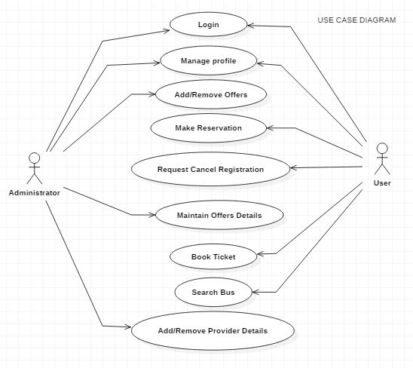
Use case Diagram

Slide 12
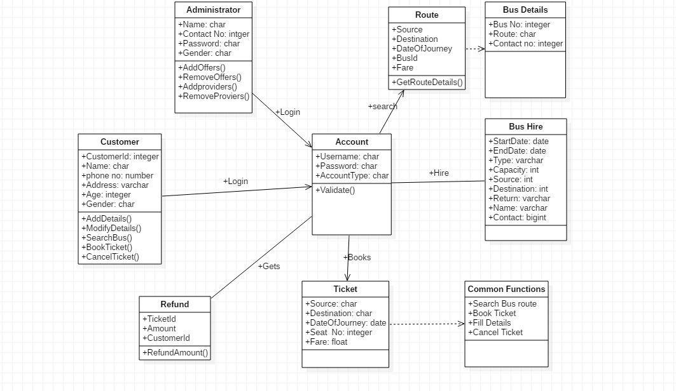
Class Diagram

Slide 13
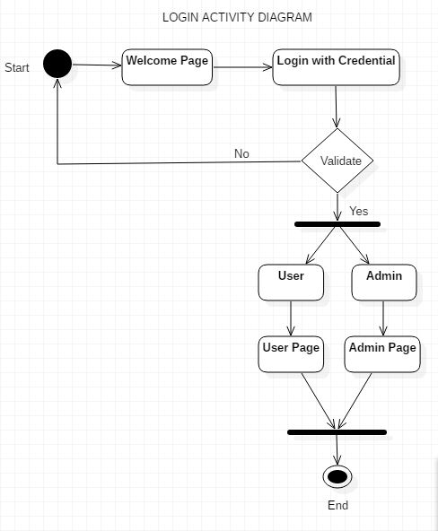
Login Activity Diagram

Slide 14
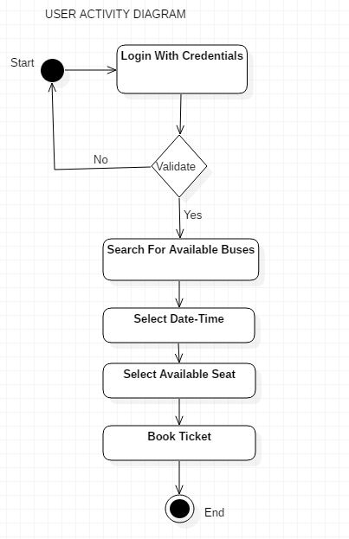
User Activity Diagram

Slide 15
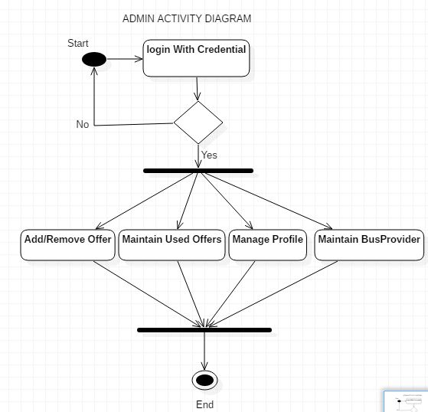
Administrator Activity Diagram

Slide 16
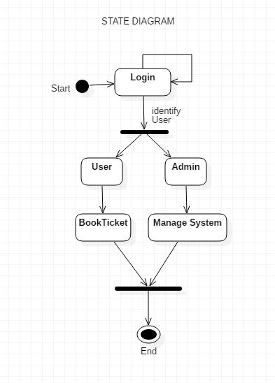
State Diagram

Slide 17
Database Design
Online Bus Ticket Booking system

Slide 18
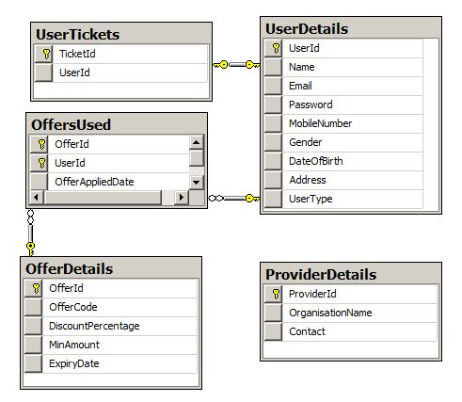
Application-Side Database

Slide 19
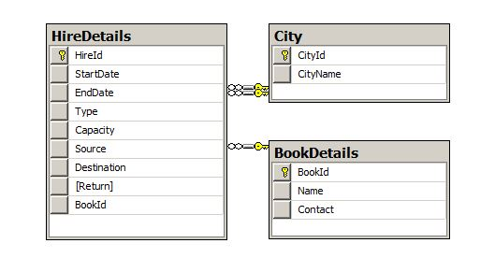
Bus-Hire Database

Slide 20
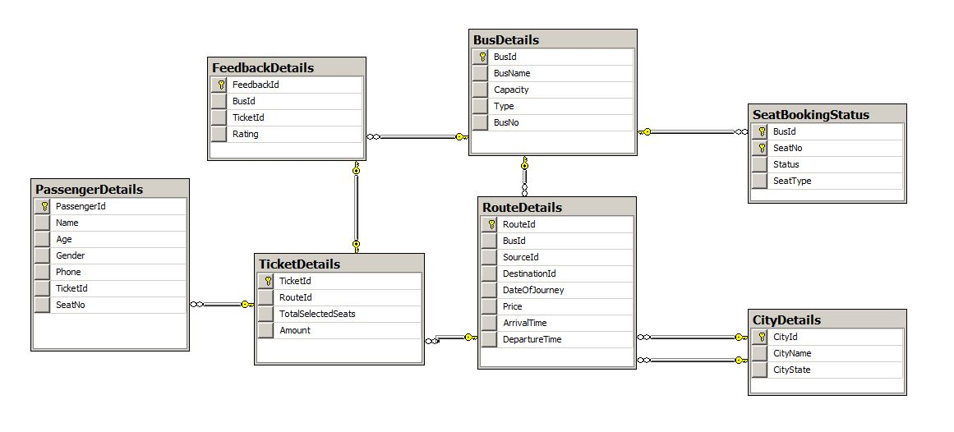
Bus-Provider Database

Slide 21
Web-Service Working
We are providing the web services for bus providers.
Bus provider have to create there own web service with all the details like Bus details, Route details, City details, etc.
We had created procedures to perform core operations on application.
Consuming web service to application with the help of XML, SOAP, WSDL, etc.
Use that different web services of different bus providers with system to perform operations throughout the application.

Slide 22
Project Screenshot
Online Bus Ticket Booking system

Slide 23
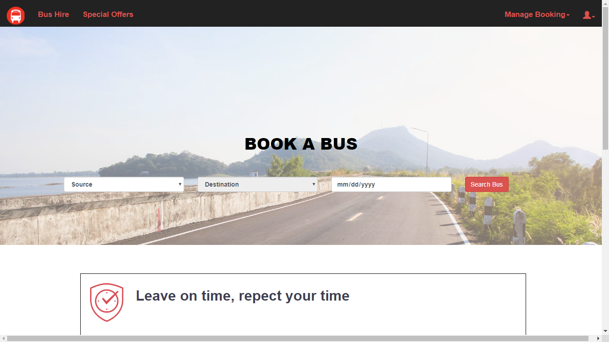
Home Page

Slide 24
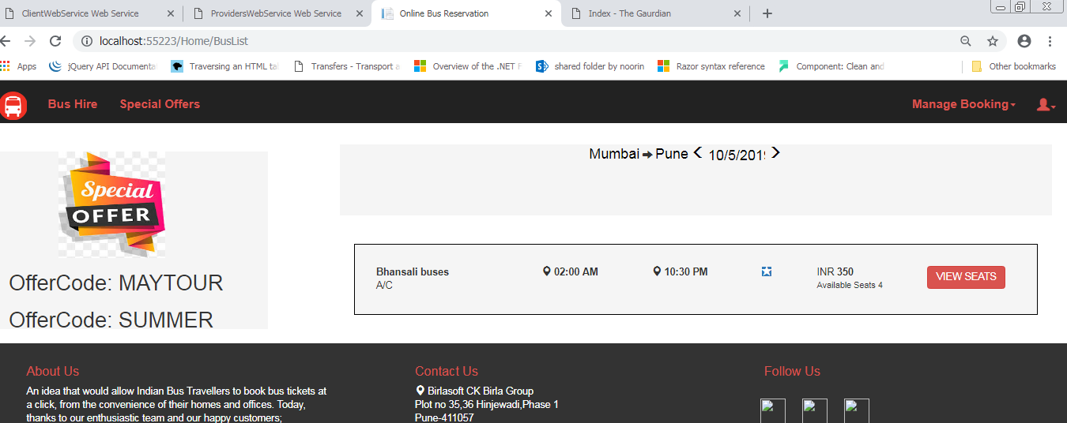
Search Buses

Slide 25
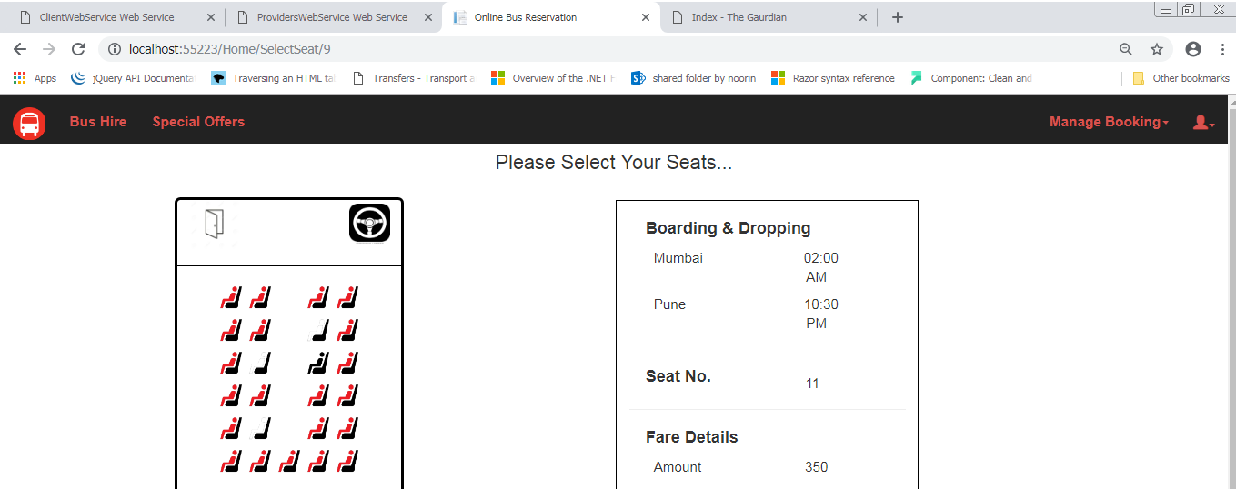
Ticket Booking

Slide 26
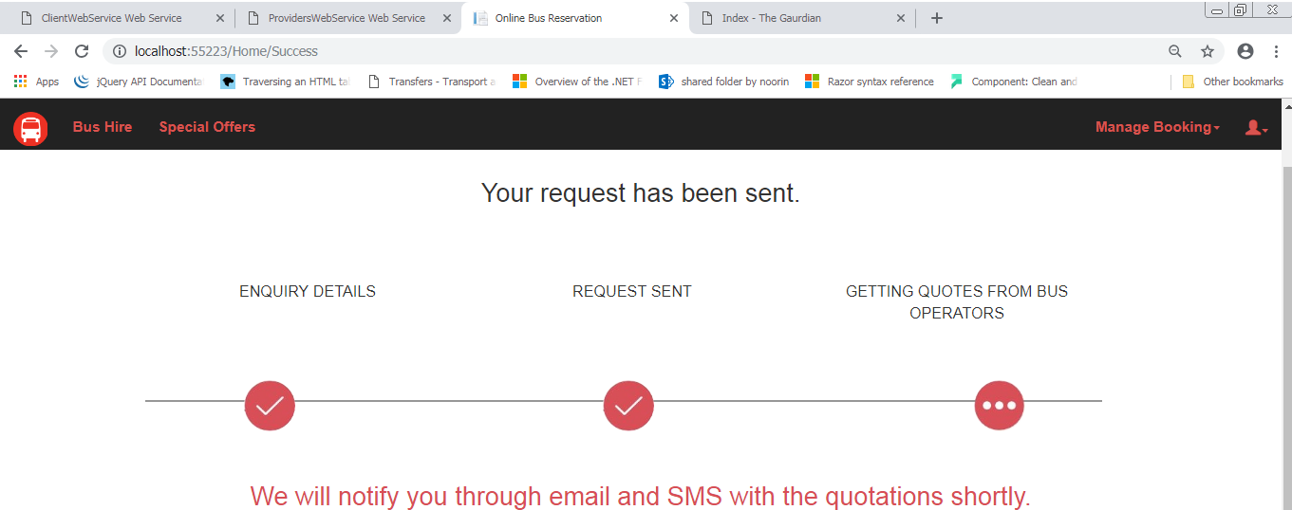
Bus Hire

Slide 27
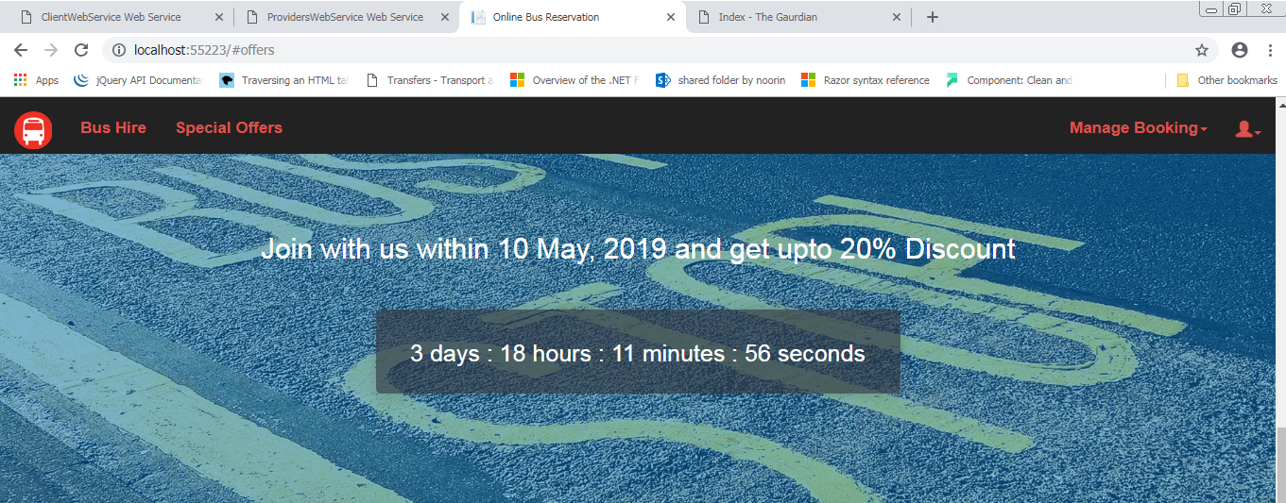
Offers Countdown

Slide 28
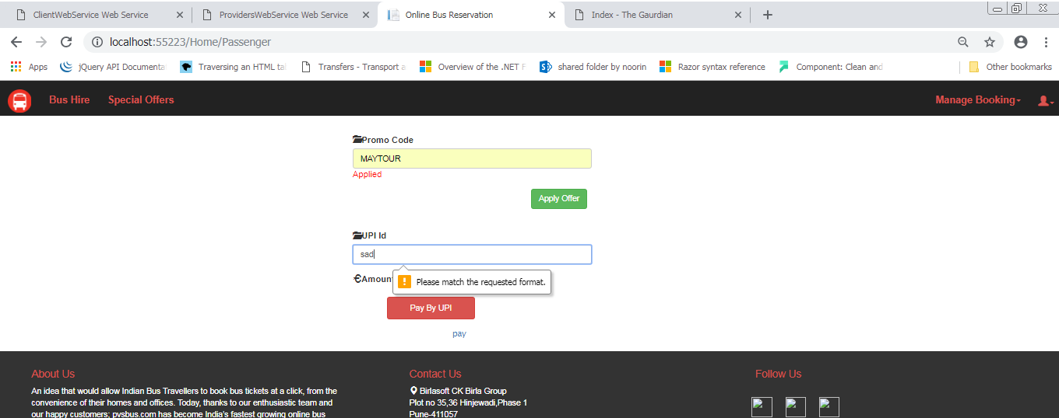
Offer-Used

Slide 29
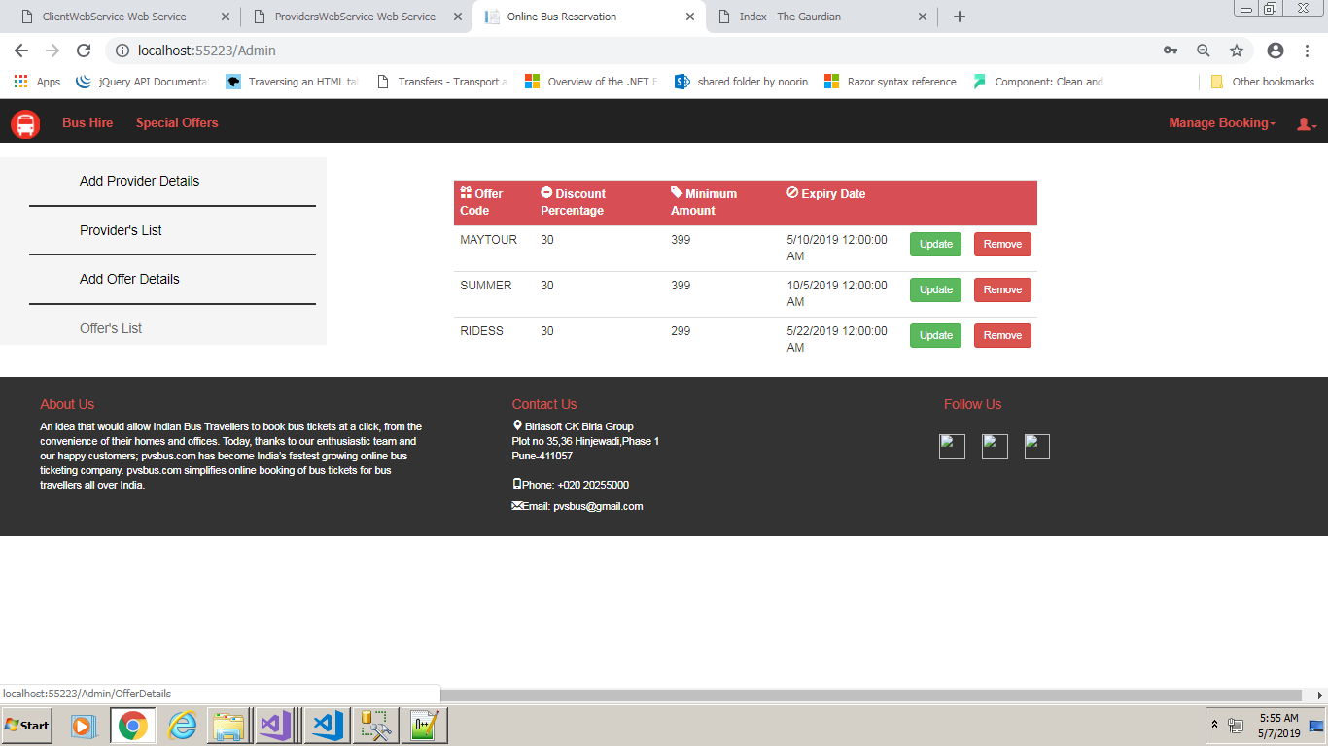
Administrator Home Page

Slide 30
Future Scope

Slide 31
Future Scopes
It will provide the live tracking of the bus with time of bus arrival.
It will suggest hotels when you reach at destination.
We can make online payment for tickets.

Slide 32
Conclusion

Slide 33
Conclusion
PVS Bus Service is a online system, which enable customer to check availability for bus ticket, buy bus ticket and pay for bus ticket.
It makes the customer easy to get bus ticket online instead of queue up to buy the bus ticket.

Slide 34
Any Questions…?

